Slide 1
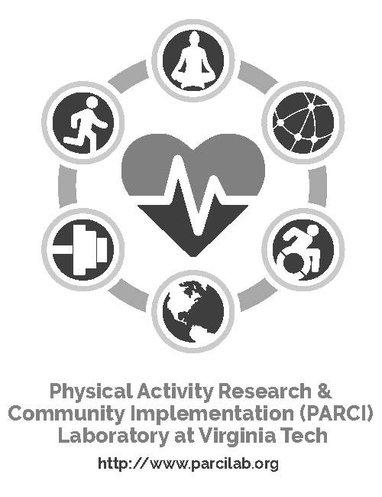
INSERT STATE/ORGANIZATION LOGO HERE
LIFT – Lifelong Improvements through Fitness Together

Slide 2
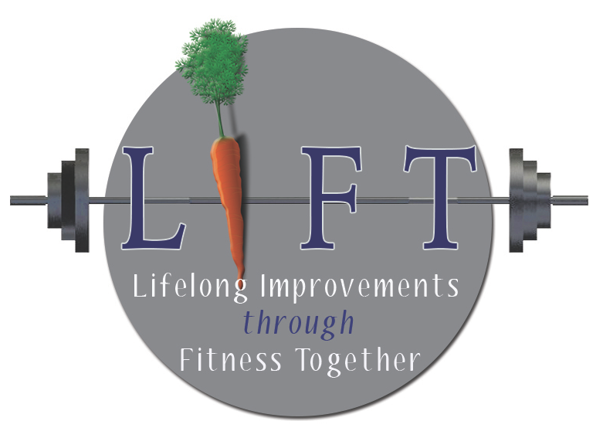
LIFT was adapted from existing evidence-based programs to meet the needs of Virginia Cooperative Extension. The results: An open-access program for all aging adults delivered in partnership with Extension, across the nation.
LIFT – Lifelong Improvements through Fitness Together

Slide 3
Promotes balance, flexibility, and strength training to improve functional fitness, allowing older adults’ to age in place and live comfortably independent longer.
LIFT – Lifelong Improvements through Fitness Together

Slide 4
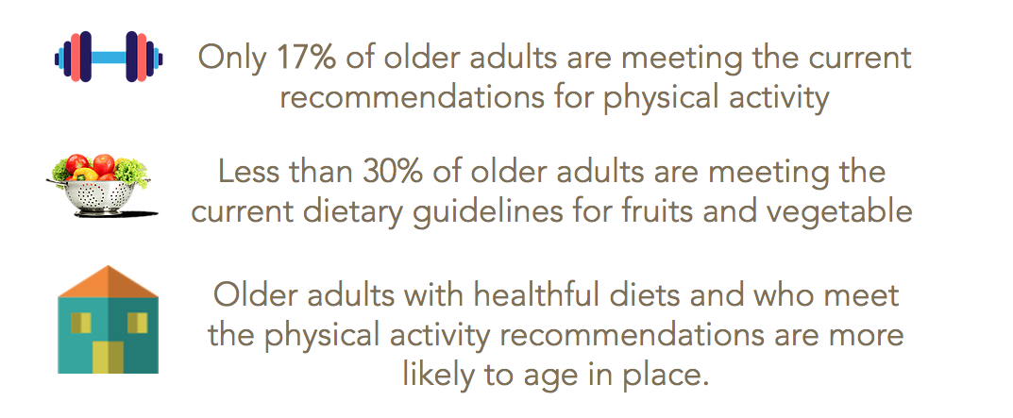
AGING ADULTS & PHYSICAL ACTIVITY
LIFT – Lifelong Improvements through Fitness Together

Slide 5
LIFT – Lifelong Improvements through Fitness Together

Slide 6
LIFT – Lifelong Improvements through Fitness Together

Slide 7
Physical Activity Reduces Risk of Falls
Ability to do daily tasks
Strength & balance
Bone density
Arthritis symptoms
Metabolic rate
Glucose control & lipid profile
Muscle mass
LIFT – Lifelong Improvements through Fitness Together

Slide 8
Physical activity can improve your mental health, too:
Improves your mood & attitude
Decreases depression
Allows you to sleep more soundly
Provides an opportunity for you to socialize
Increases your energy levels
LIFT – Lifelong Improvements through Fitness Together

Slide 9
Class Details
We meet 2 times a week.
Classes are 1 hour long.
The session is 8 weeks long.
That’s 16 sessions!!!
LIFT – Lifelong Improvements through Fitness Together

Slide 10
LIFT Core Elements- For participants
Have fun
Stay in range of motion
Don’t use momentum to get “to the exercise”
Attend class 2x/week for 8 weeks
Track aerobic activity outside of class
Build relationships with peers
Learn about resources in the community
Measure progress

Slide 11
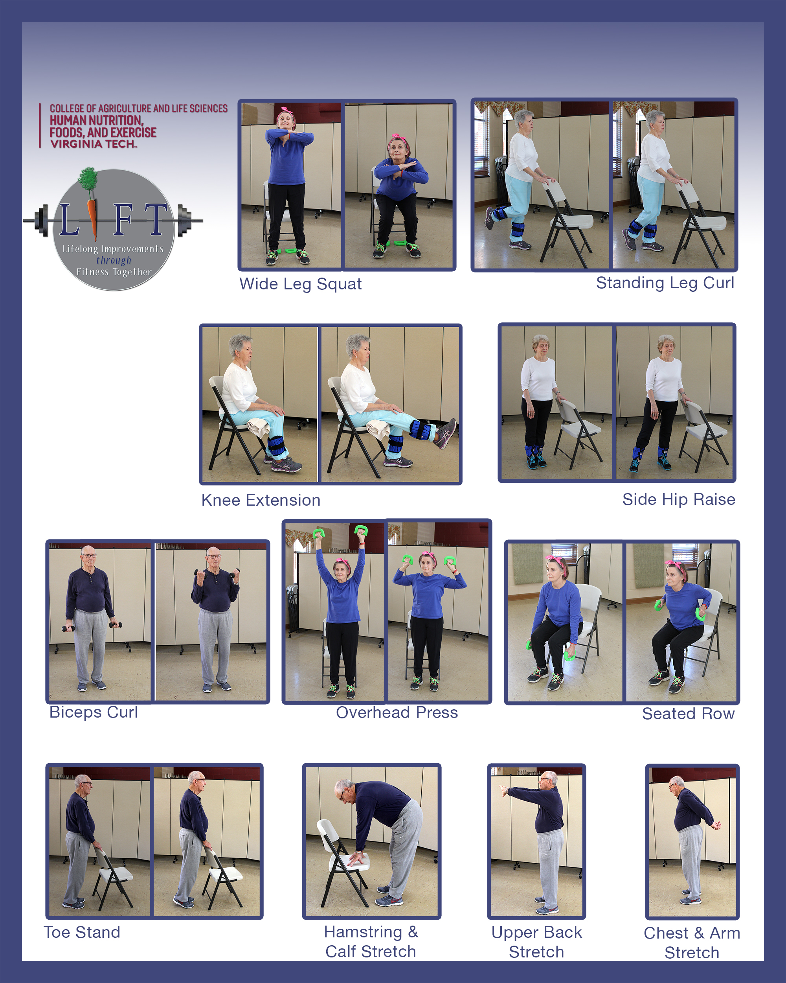
Every LIFT class includes:
Warm up
8 core strength training exercises
Social engagement
Encouragement to eat more fruits and vegetables
Planning for cardio exercises outside of class
Cool down
LIFT – Lifelong Improvements through Fitness Together

Slide 12
LIFT has pre, post and 6 month follow up assessments
LIFT – Lifelong Improvements through Fitness Together

Slide 13
Why measure?
Functional fitness is the ability to accomplish tasks of daily living.
Measuring functional fitness before, after, and 6 months later allows us to track individual-level improvements over time.
These data help us communicate to stakeholders about the benefits of offering the program in your community.
Participating in LIFT means you are also participating in research to help us be a healthier society!
LIFT – Lifelong Improvements through Fitness Together

